Slide 1
WELCOME TO AMAZON SALES ANALYSIS
PRESENATION

Slide 2
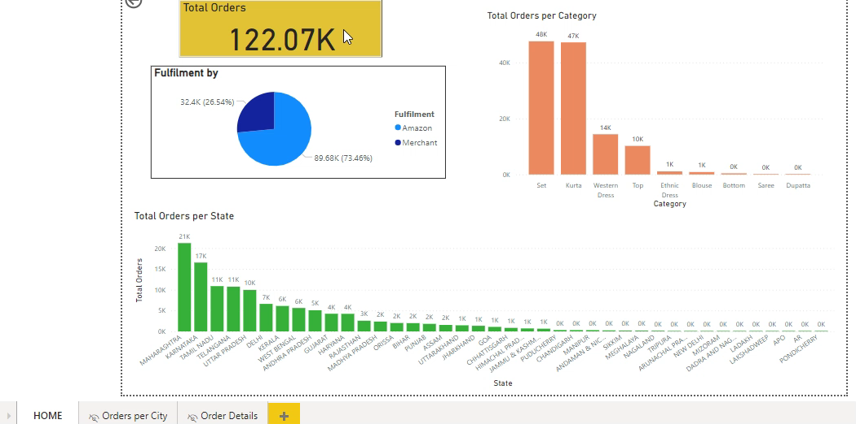
Visual Performance

Slide 3
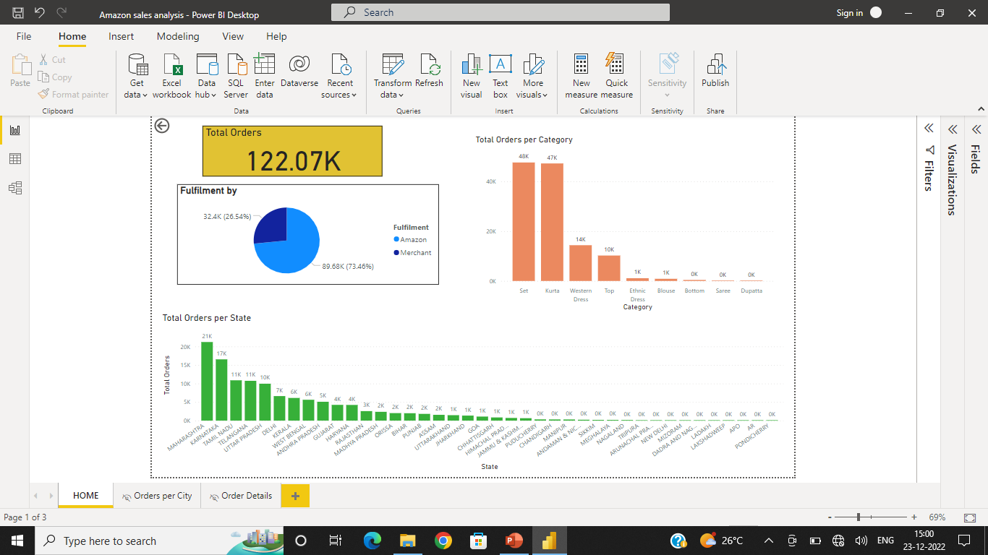
HOME Page

Slide 4
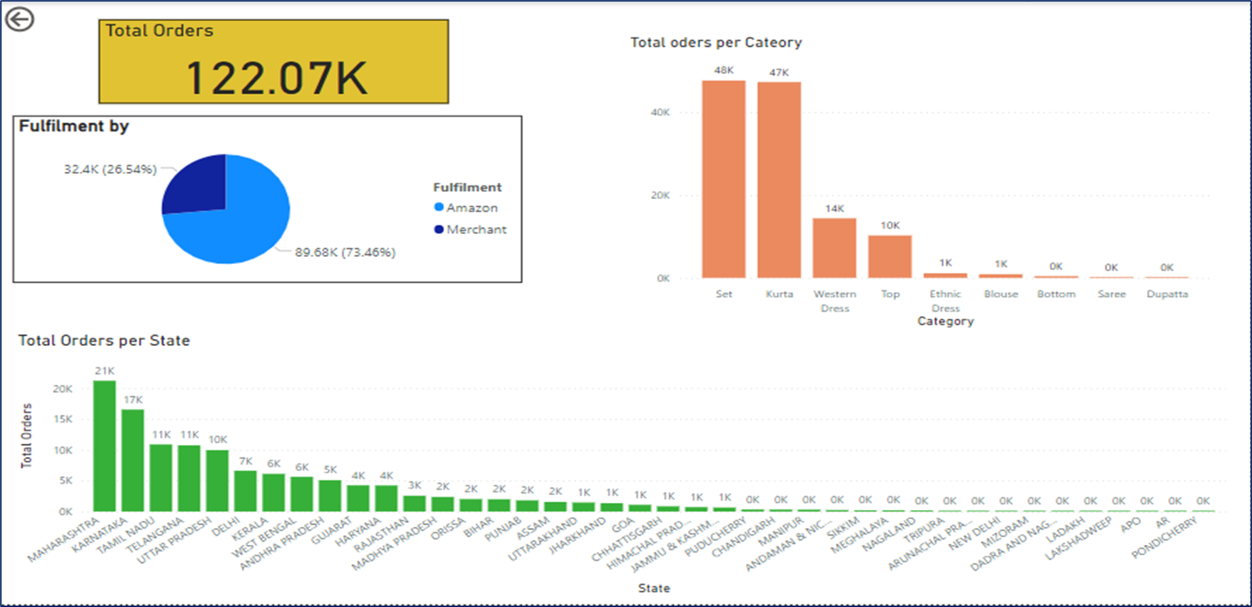
Total Orders
Represents the total number of orders
We can observe that total number of orders are approximately 122,000

Slide 5

Fulfilment by
Represents by whom the orders were fulfilled either by Amazon or local merchants/traders.
We can notice that majority of the orders are being fulfilled by Amazon i.e. 89,680.
Whereas the 32,400 number of orders were fulfilled by the Local Merchants/Traders.

Slide 6
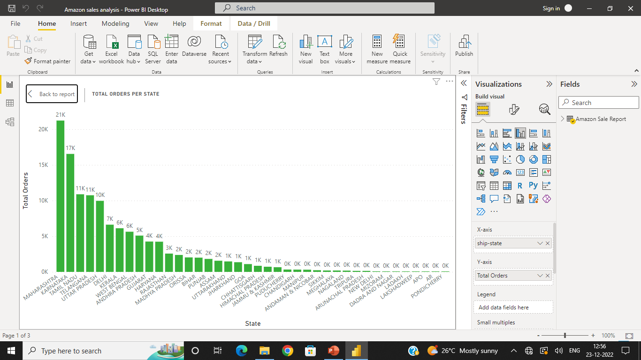
Orders per State
This visual represents the number of orders per State.
From this visual, we can conclude that maximum number of orders are from Maharashtra which round up to 21,000 and Karnataka being the top 2nd on the list with almost 17,000 orders.

Slide 7
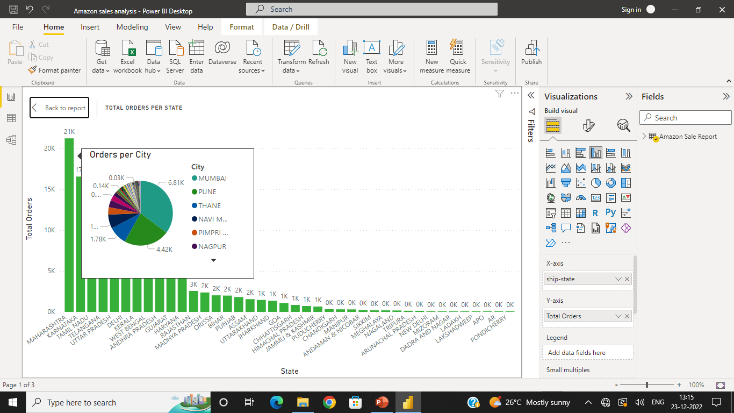
Orders per City
If we drill through the TOTAL ORDER PER STATE Visual, we can get the data related to number of orders from different cities.
For example, if we ware drilling through the MAHARASHTRA State, we can observe that most number of orders are from Mumbai and Pune cities compared to others.

Slide 8
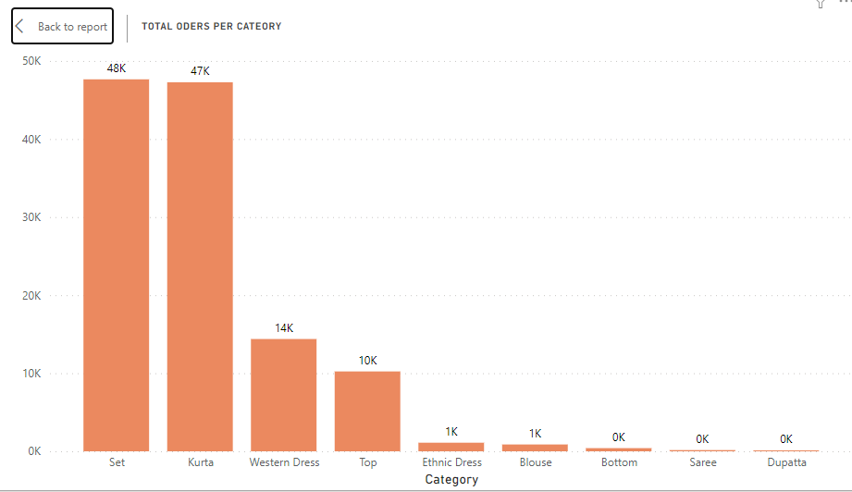
Orders per Category
This visual represents the total number of orders under different category of clothing pieces.
We notice that Set is in high demand with 48K orders for it.
It is followed with Kurta and Western dresses with 47,000 and 14,000 orders for each.

Slide 9
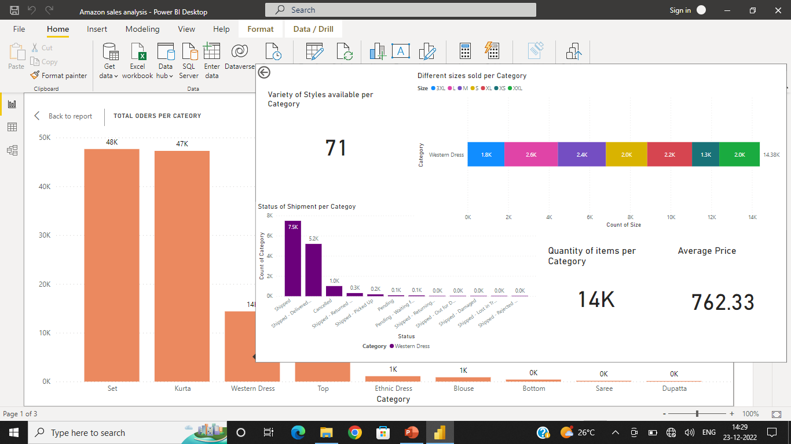
Drill through Orders per Category
If we need more details about the various clothing pieces which are being ordered, we can drill through Orders per Category.
For example, if we want more details about the Western dress Category, we can drill through to get those details.
Each visual is explained in the following slides.

Slide 10
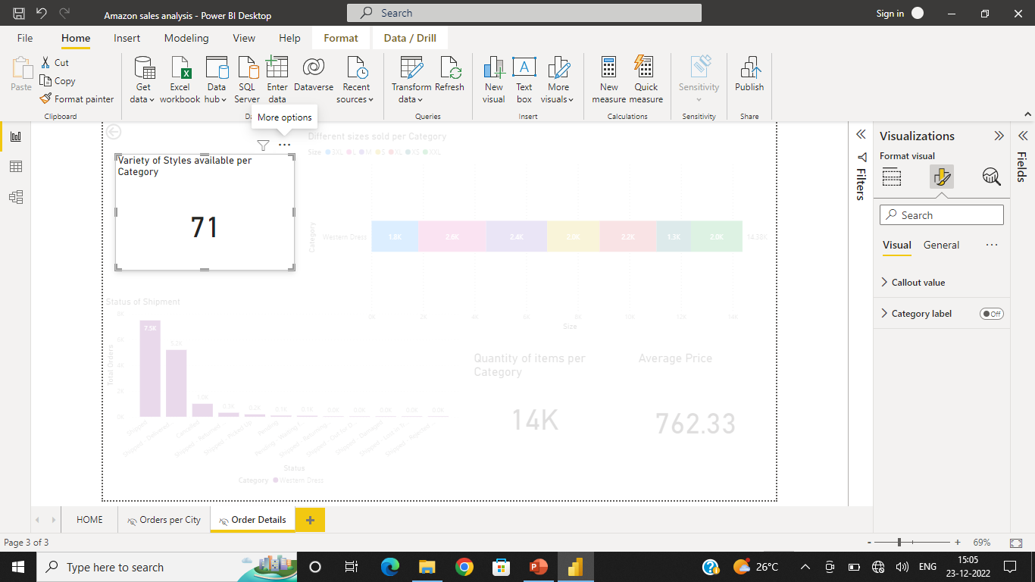
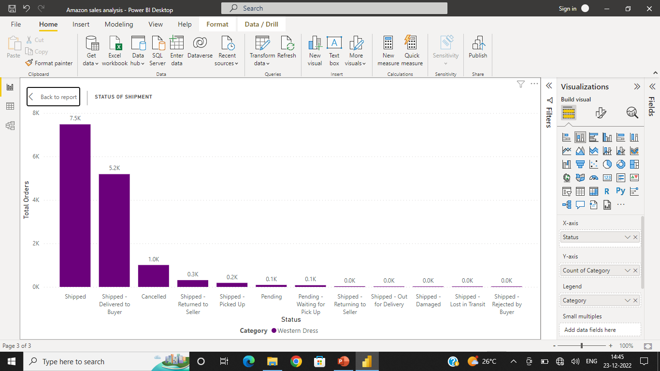
Shows the different styles available under a cloth category
Shows the status of the shipment
We notice that most of the Western dresses have already been shipped and have been delivered to buyer too.

Slide 11
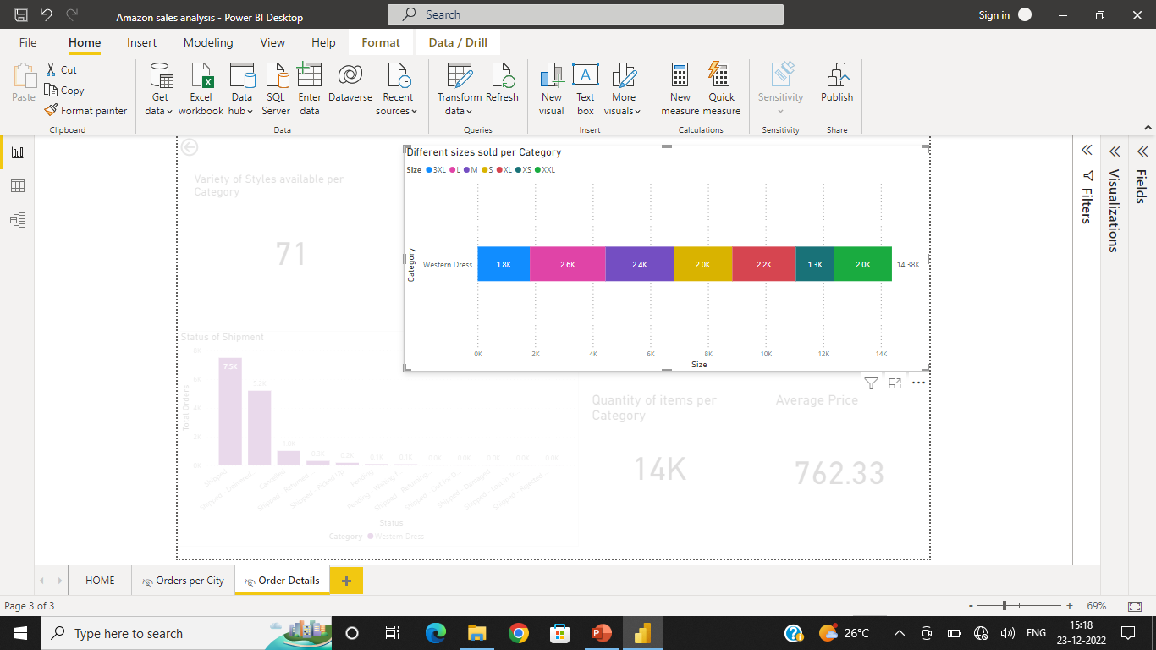
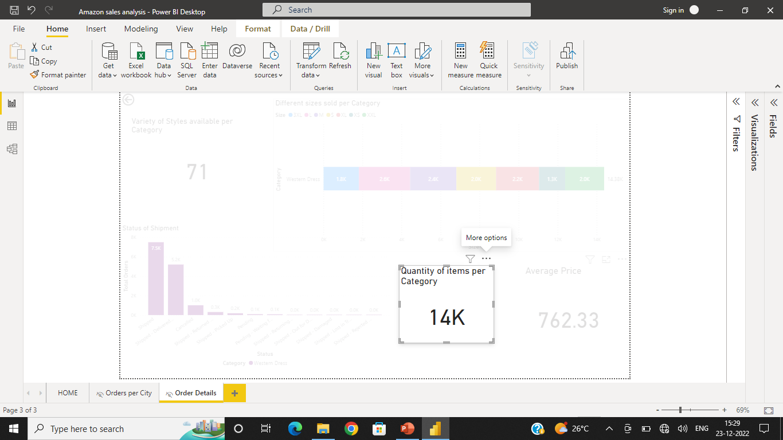

This visual explains the which size is in highly ordered.
For, the Western dress, we can observe that L size dress in high in demand
Represents the total number of pieces ordered regarding a particular clothing piece
Here, we are looking based on Western dress, so we can conclude that a total of 14,000 Western dress were sold.
Represents the average price of the clothing piece
Here, we are considering the Western dress category, so we can conclude that average price of Western dress is 762 Rs.

